Slide 1

The Framingham Heart Study
Coronary Heart Disease
Risk Factor Analysis and Predictions
Notes:
Alternative Slide 1+2 (Chun)
Hi everyone, we will be studying risk of heart disease from the Framingham Heart Study. I am Ryan,

Slide 2

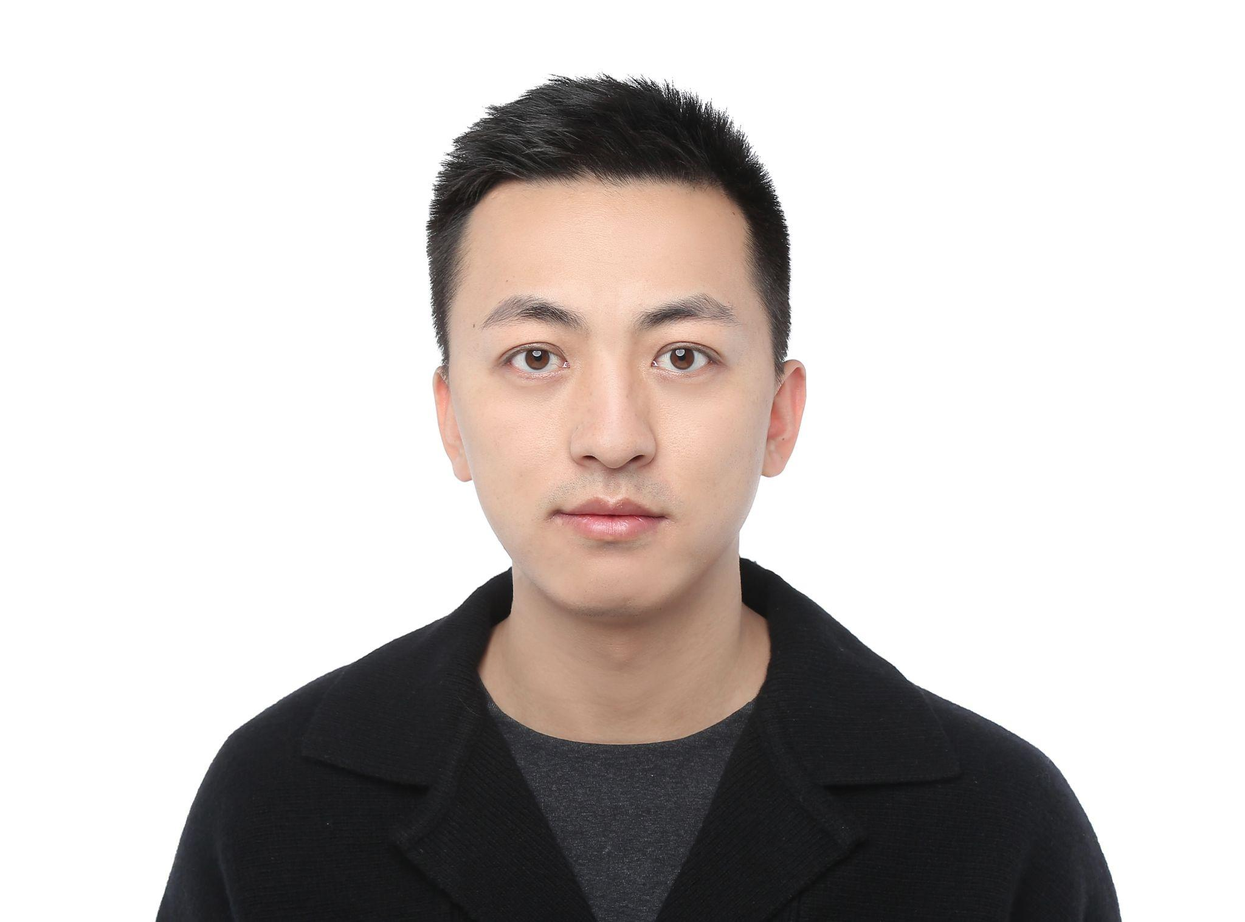
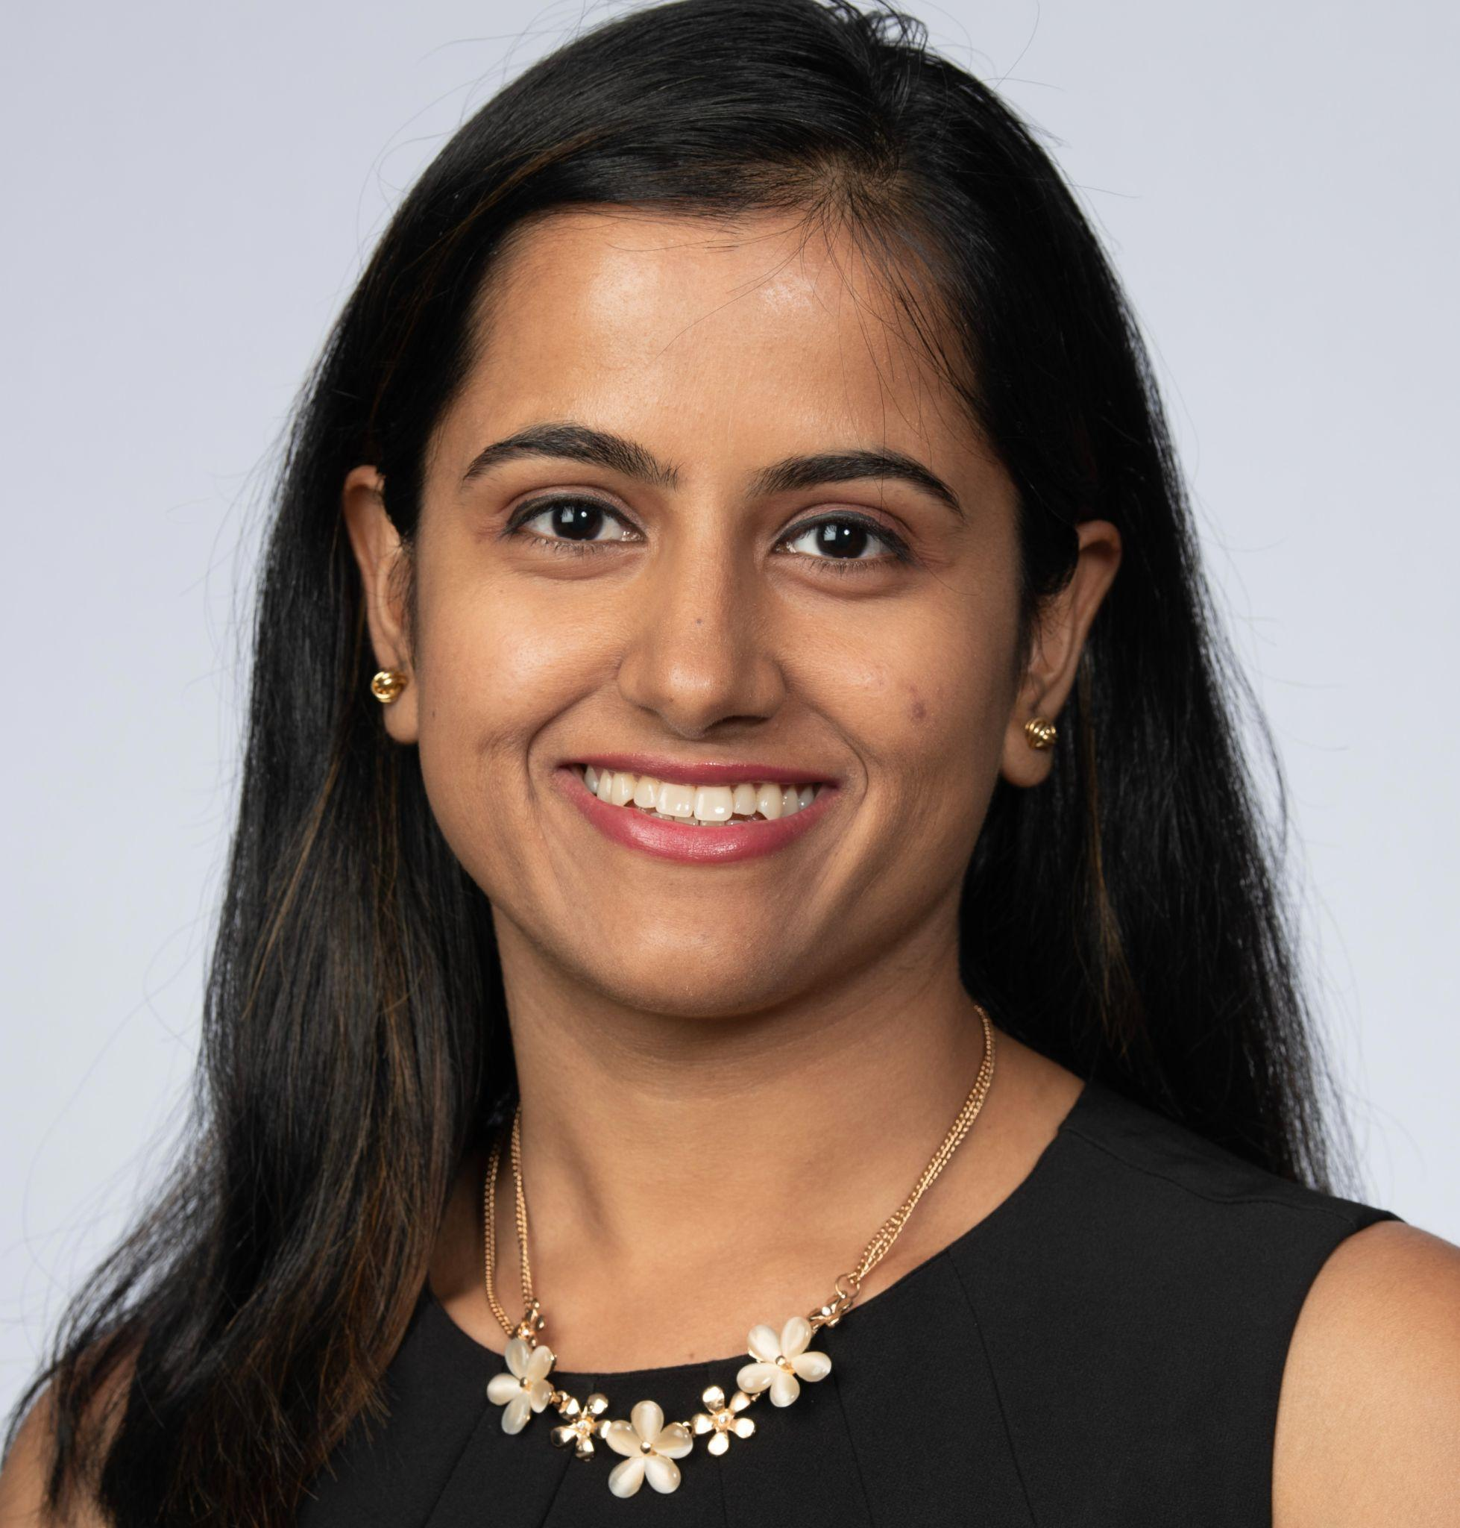

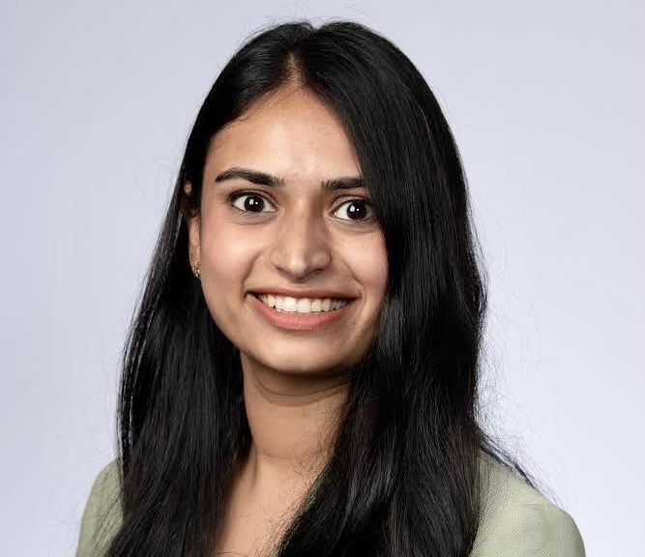
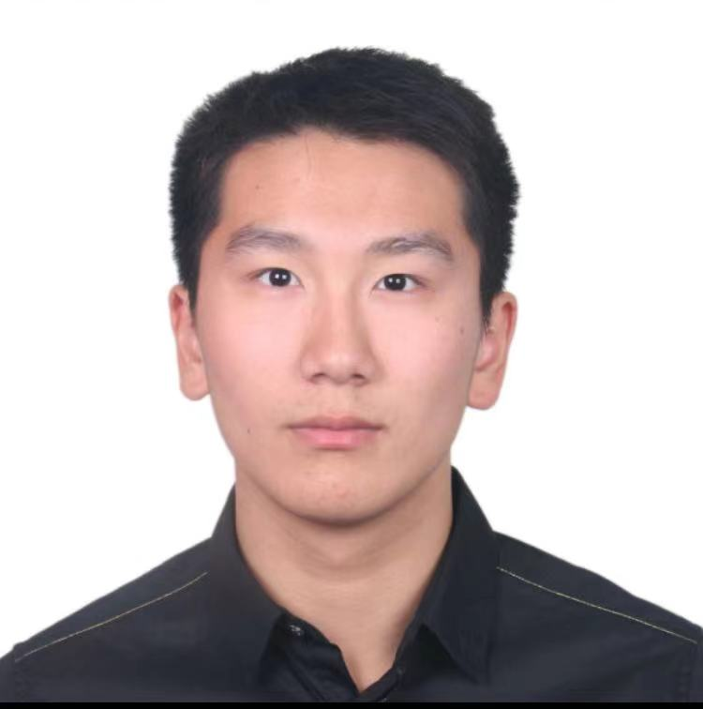
Meet Our Team
Ryan
Nie
Zhenyang
Gai
Chinar Boolchandani
Urvashi
Tripathi
Kaiyu
Wang
Chun
Zhou

Slide 3



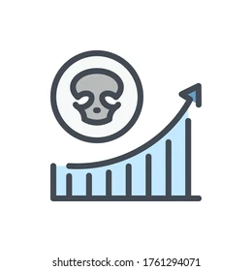
Study Background
This research studies the longitudinal cardiovascular disease dataset from 5,209 residents living in Framingham, Massachusetts.
It predicts if patients will have coronary heart disease (CHD) in ten years using risk factors of demographics, behaviors and medical results.
Financial losses
A growing problem
Heart disease costs the US about $219 billion each year. This includes the cost of healthcare services, medicines, and lost productivity due to death
Cases doubled from 250 million in 1990 to 500 million in 2019, while deaths steadily increased from 12.1 million to 18.6 million
No cure
CHD cannot be cured but treatment can help manage the symptoms and reduce the chances of heart attacks
High mortality rate
About 655,000 Americans die from heart diseases each year—that’s 1 in every 4 deaths
Notes:
We are hoping to build a model that predicts a person’s risk of coronary heart disease
Why should you care?

Slide 4
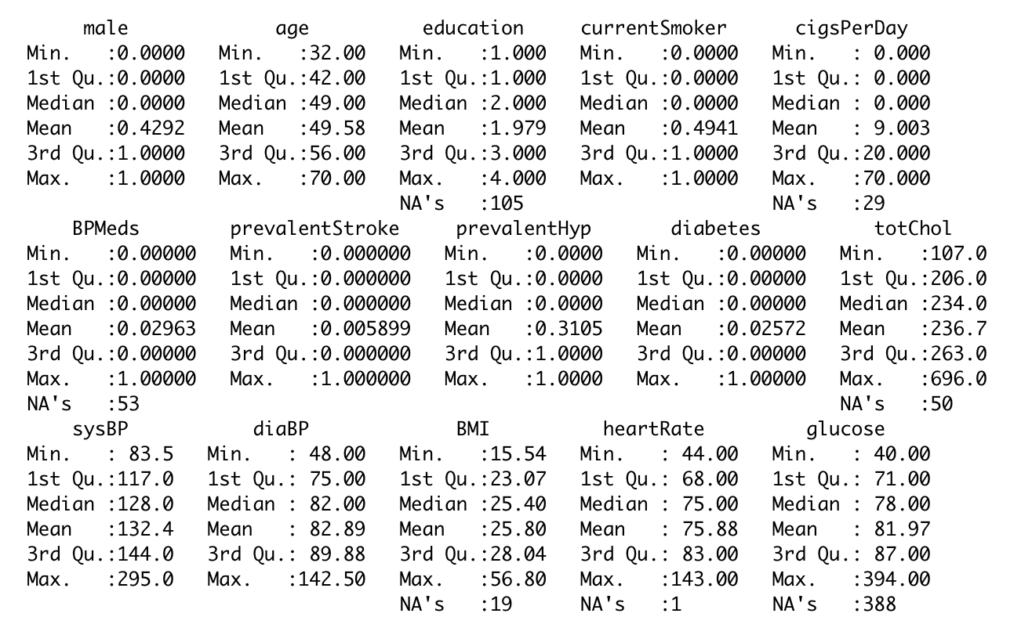
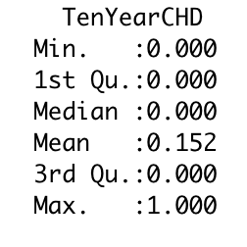
Dataset Features
Dataset
Collected by World Health Organization (WHO), downloaded from Kaggle
15 Attributes: demographic (e.g. gender, age), behavioral (e.g. smoker) and medical (e.g. bmi, blood pressure)
Over 4000 records

Slide 5
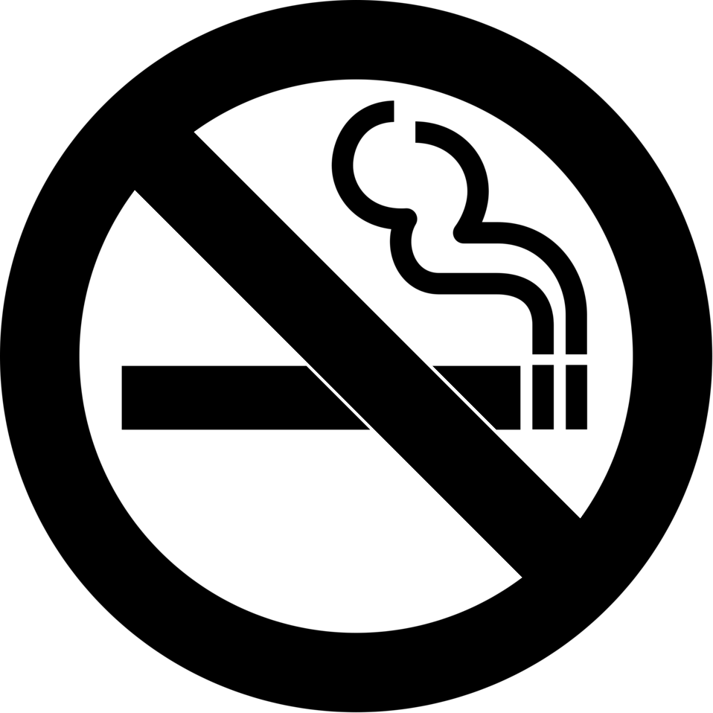


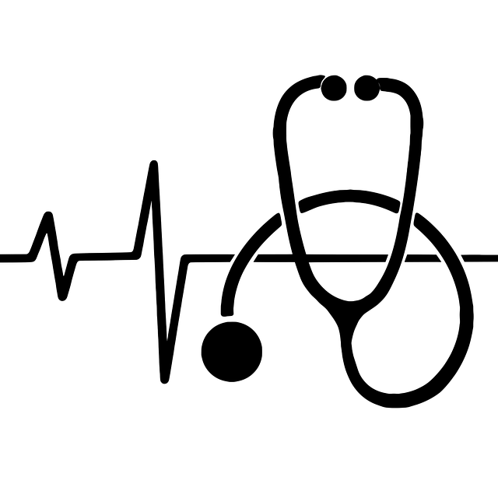
Sample Hypotheses
We list out example hypotheses that we will prove/disprove; The list is not exhaustive
Smoking increases risk of CHD
Comorbidities are positively correlated to CHD
Medication reduces the risk of CHD
CHD risk is correlated to demographic/behavioral factors
How does risk of CHD vary with smoking habits?
Are chronic diseases such as diabetes and hypertension correlated to CHD?
Does medication adherence show a negative correlation to CHD risk and can it play a preventative role?
Given your level of cigarettes per day and your gender, are you at risk for CHD ?

Slide 6
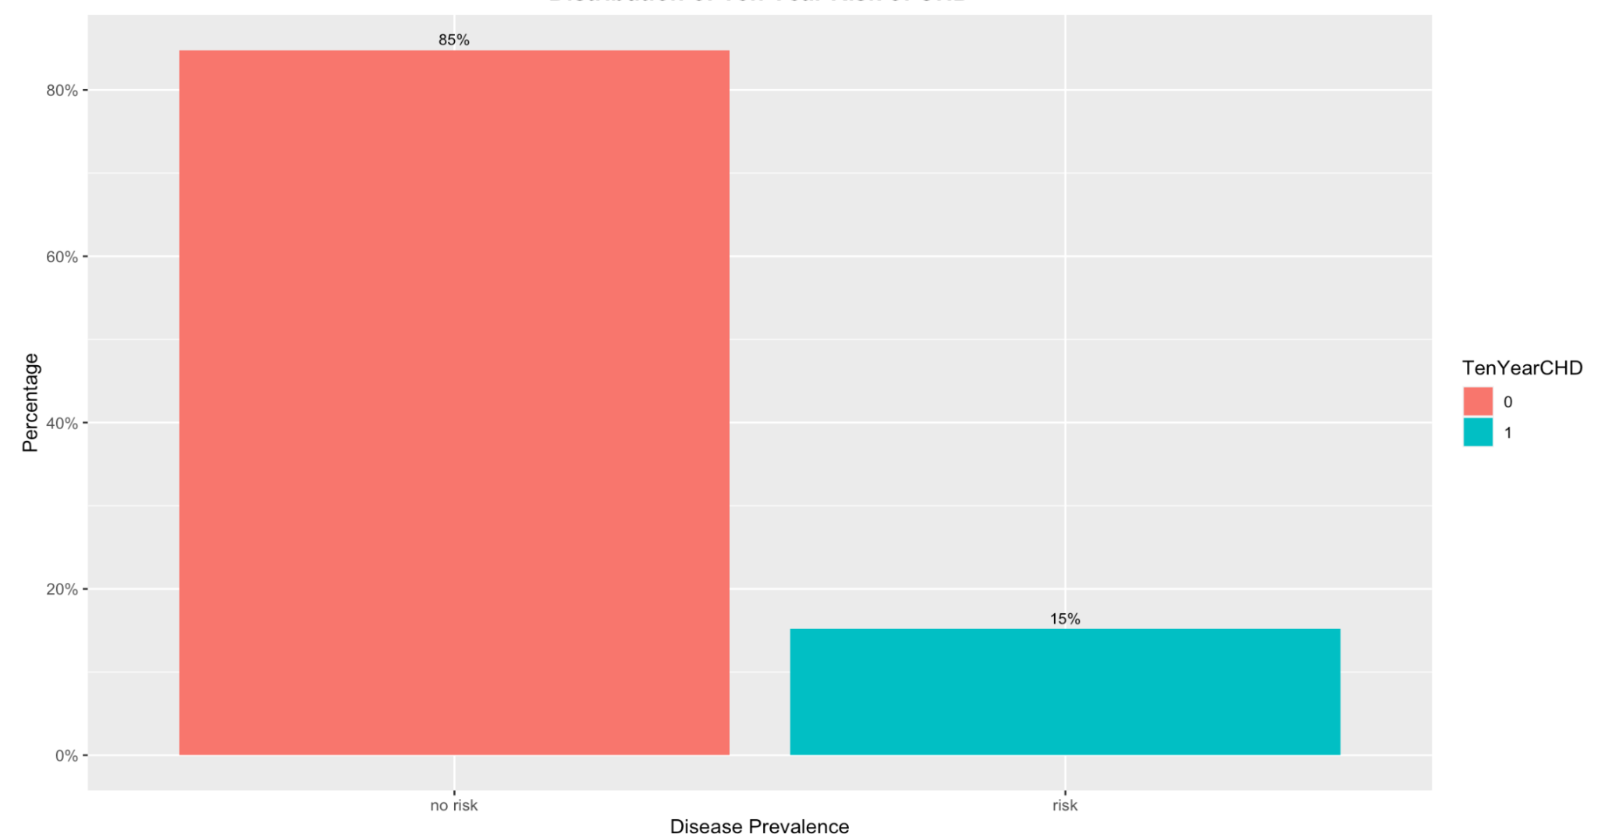
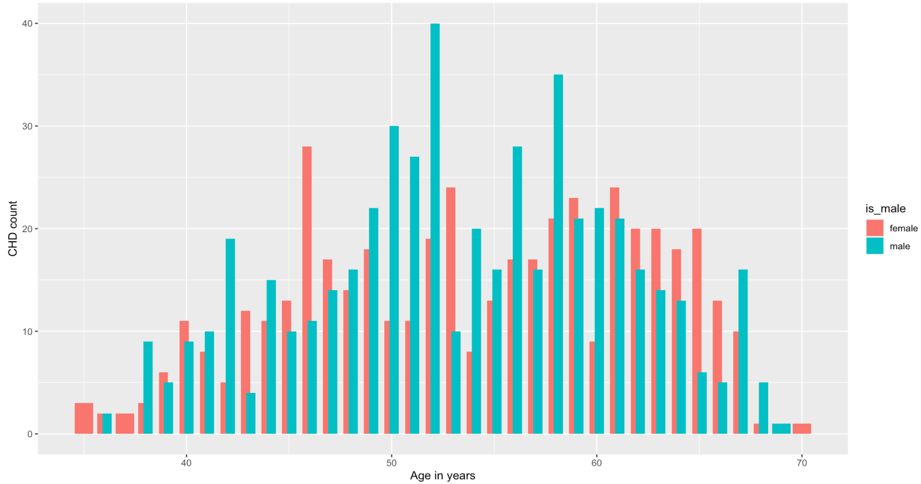
Descriptive Data Analysis
Distribution of TenYearCHD
Distribution of TenYearCHD with Age and Gender
Graph
Graph
There is some imbalance in our dataset with Target Variable : TenYearCHD
Females are more likely to have CHD in age groups 45-55 above, whereas males are more likely to have CHD in ages 50-60
Notes:
Say conclusions/insights

Slide 7
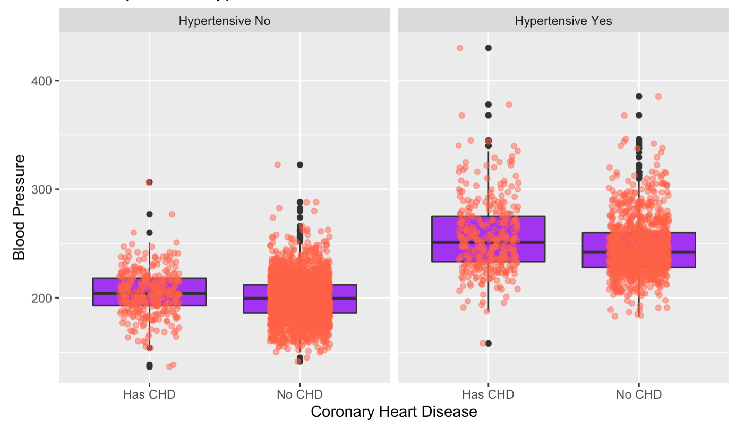
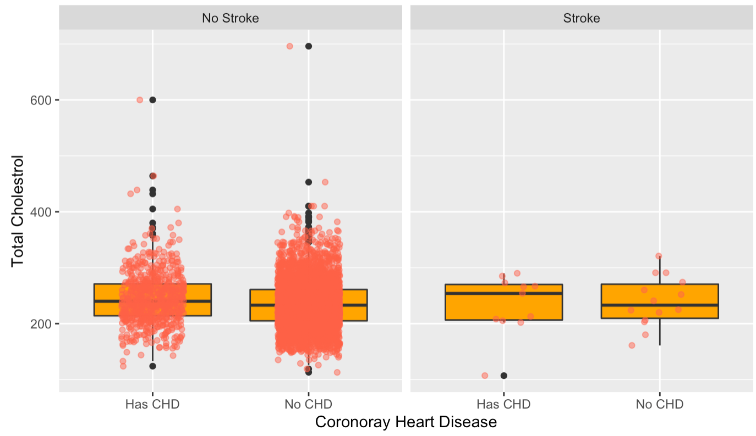
BP, Total Cholesterol, Prevalent Hypertension and Prevalent Stroke relationship with CHD
BP - prevalentHyp vs CHD
TotChol - prevalentStroke vs CHD
Graph
Graph
Prevalent Hypertension and BP seem positively related to CHD
Median Total Cholesterol level is higher for people with CHD and history of stroke
Notes:
Say conclusions/insights

Slide 8
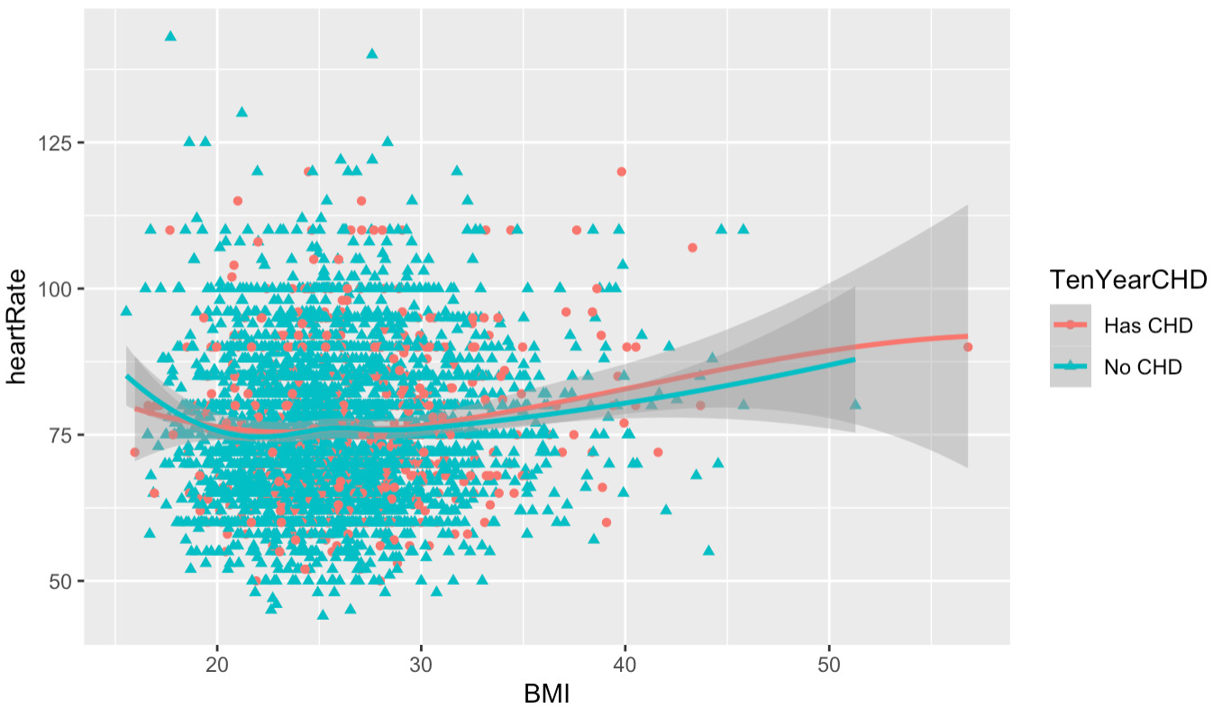
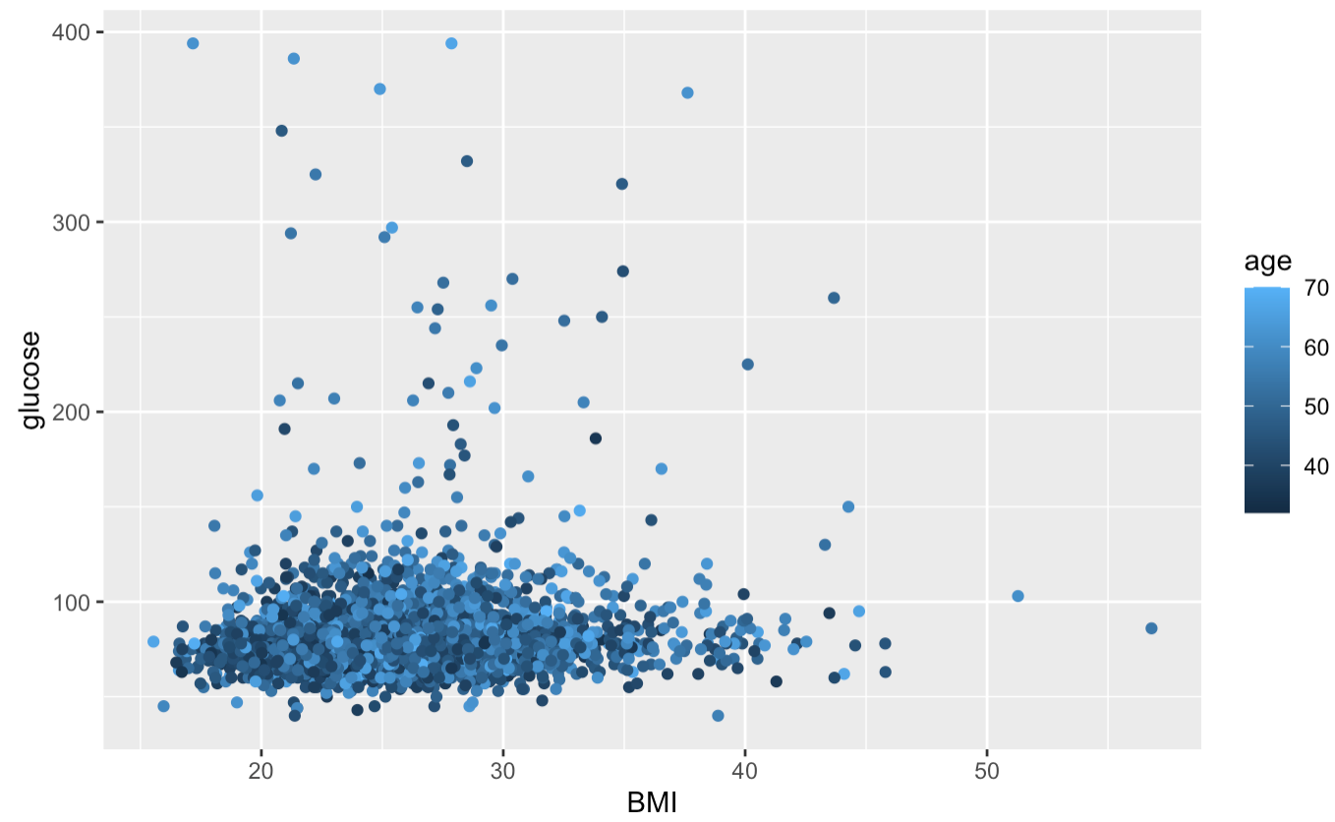
BMI and heart rate relationship with target variable
BMI - HeartRate vs CHD
BMI - glucose vs age
Graph
Graph
People with higher BMI and higher heart rate tend to be more prone to CHD in ten years
Most people in our dataset have BMI within 20-40 and glucose levels between 50-100, with some outliers with higher glucose levels mostly above age 60
Notes:
Say conclusions/insights

Slide 9
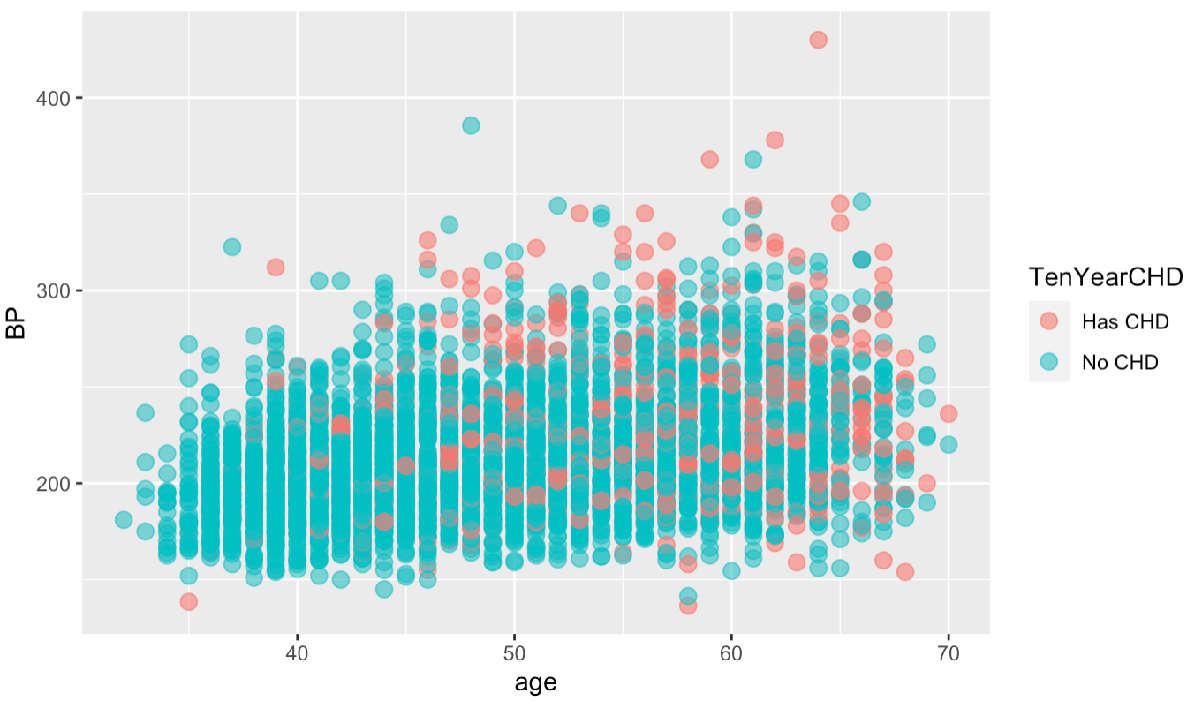
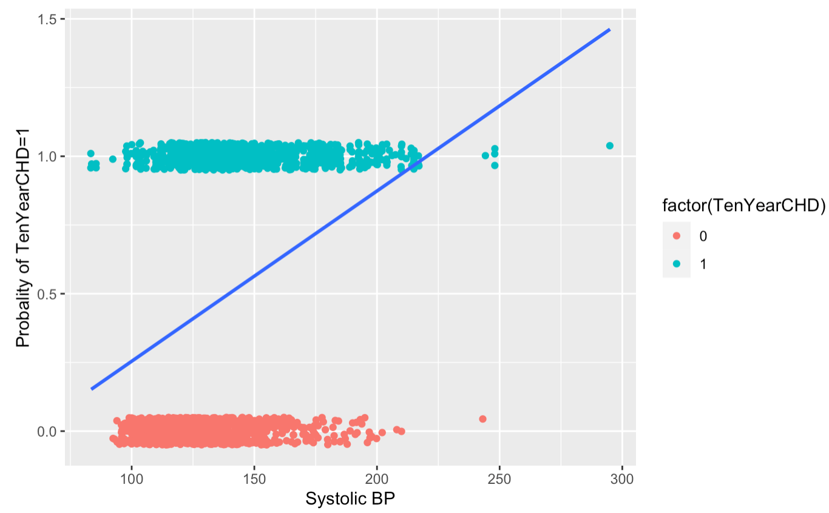
BP and age relationship with target variable
Blood pressure-age vs CHD
CHD distribution with SysBP
Overall BP seems to be higher for age groups >60 and more people tend to have CHD above age 50 and BP >200
Probability of having CHD in ten years if more for people with higher systolic BP
Notes:
Say conclusions/insights

Slide 10
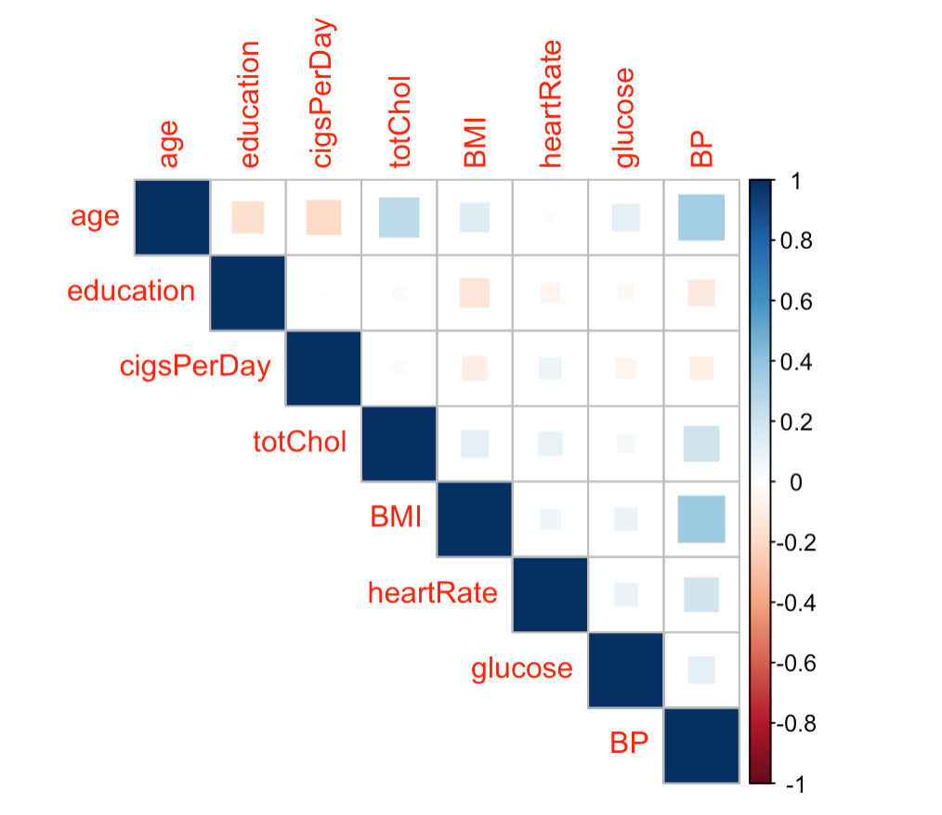
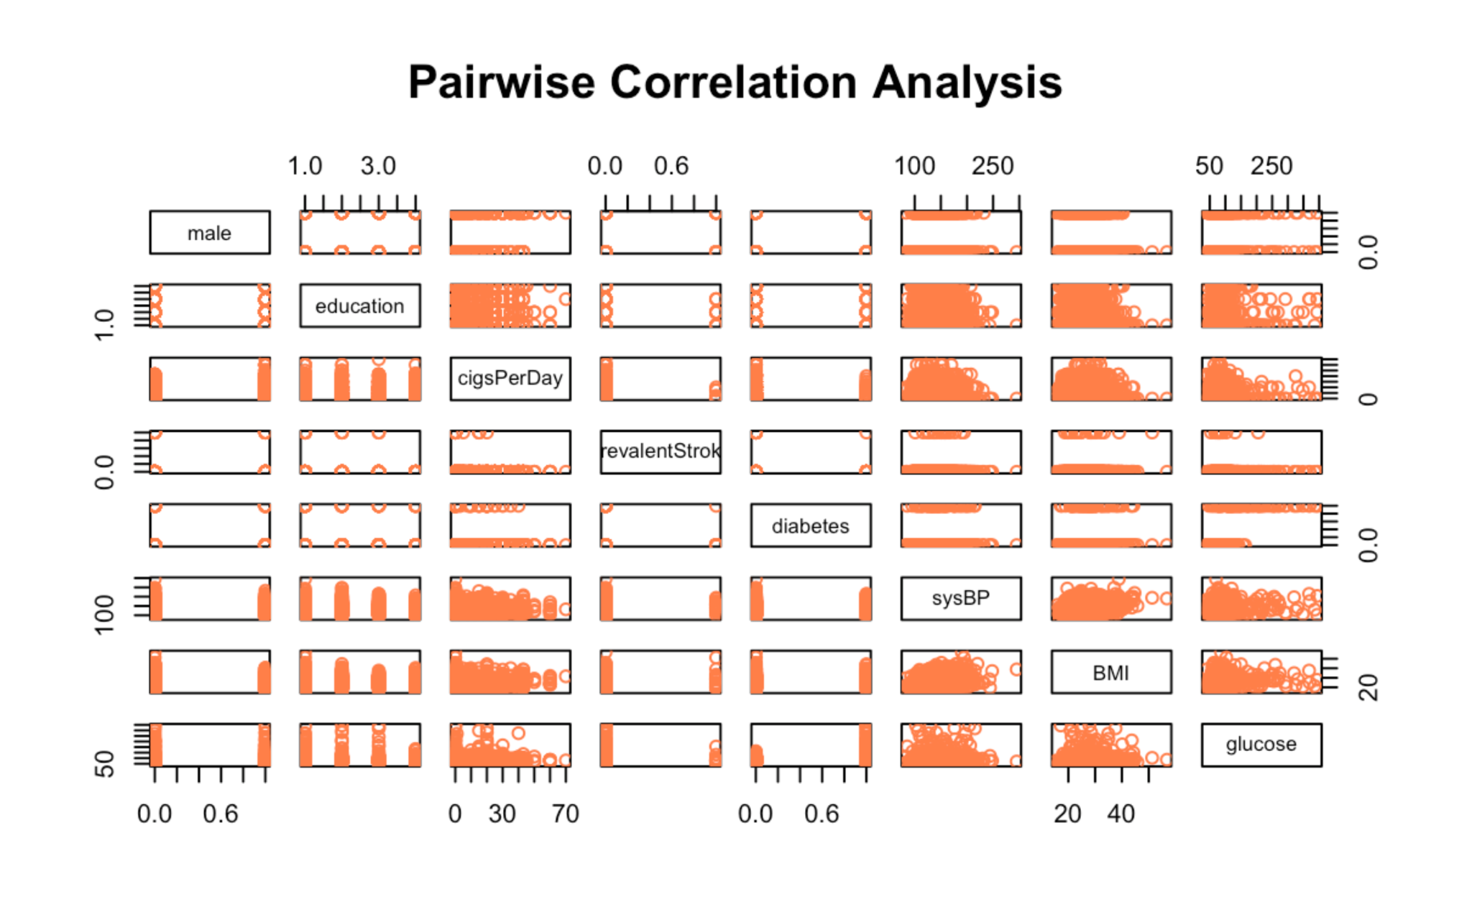
Correlation of different features in dataset
Numerical feature correlation matrix
Pairwise correlation plot
Graph
Highly correlated features:
BP - BMI, age - totChol, totChol - BP, age - education
Overall correlation of important features

Slide 11
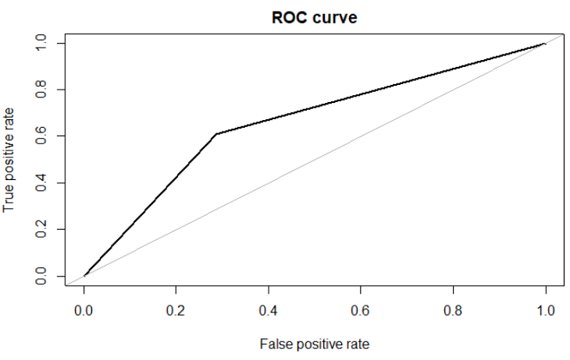
Linear Regression
Models a linear relationship between the dependent and independent variables
Roc curve
Metrics
Accuracy | 66.5%
Sensitivity | 60.7%
Specificity | 71.2%
AUC | 0.660
Notes:
While splitting data, we did both oversampling and downsampling to both training and test dataset. To make sure the percentages of CHD_0 and CHD_1 in both datasets are around 50 percent.
Before we begin discussing the models, I want to talk about how we split the dataset. We

Slide 12
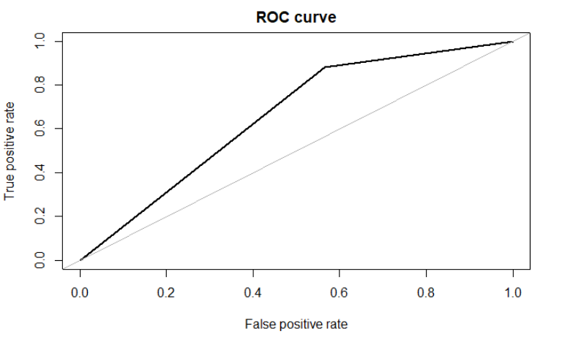
Lasso Classification
Linear regression with regularization - increases prediction accuracy and model interpretability by penalizing model for selecting higher coefficients
Roc curve
Metrics
Accuracy | 66%
Sensitivity | 87.6%
Specificity | 43.9%
AUC | 0.658
Notes:
We can roughly determine, by looking at the coefficients provided by lasso, which predictors are important for the linear related models. Someone that is diabetic and takes blood pressure medication has a greater risk of developing CHD.

Slide 13
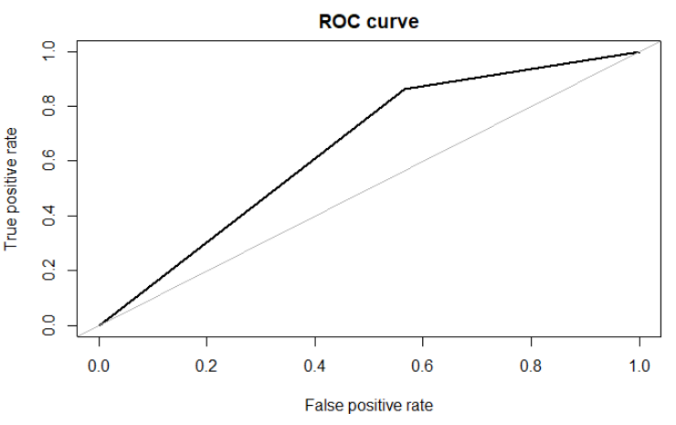
Ridge Classification
Linear regression with regularization - minimizes MSE and penalizes model for higher coefficients by adding shrinkage penalty
Roc curve
Metrics
Accuracy | 65%
Sensitivity | 86.1%
Specificity | 43.4%
AUC | 0.648
Notes:
Nothing important to mention
Ridge Classification underpoerforms Lasso classification by about 1 percent

Slide 14

Logistic Classification
A regression model which models the probability that outcome belongs to a particular category by classifying
Roc curve
Metrics
Accuracy | 66.3%
Sensitivity | 84.2%
Specificity | 48.0%
AUC | 0.661
Notes:
For logistic classification we used backward selection.
The logistic model found that diabetic and blood pressure medication are still very correlated with one’s risk for CHD. Stroke prevalence also turns out to carry more weight in the logistic model.

Slide 15
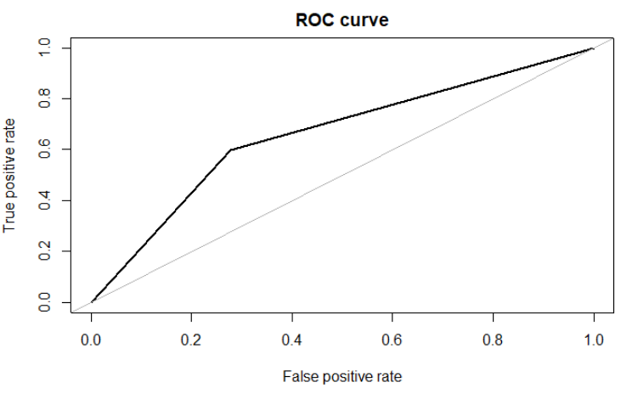
Decision Tree
A Supervised Machine Learning model where data is split according to a condition and divided into nodes and leaves
Roc curve
Metrics
Accuracy | 66%
Sensitivity | 59.9%
Specificity | 72.2%
AUC | 0.661

Slide 16
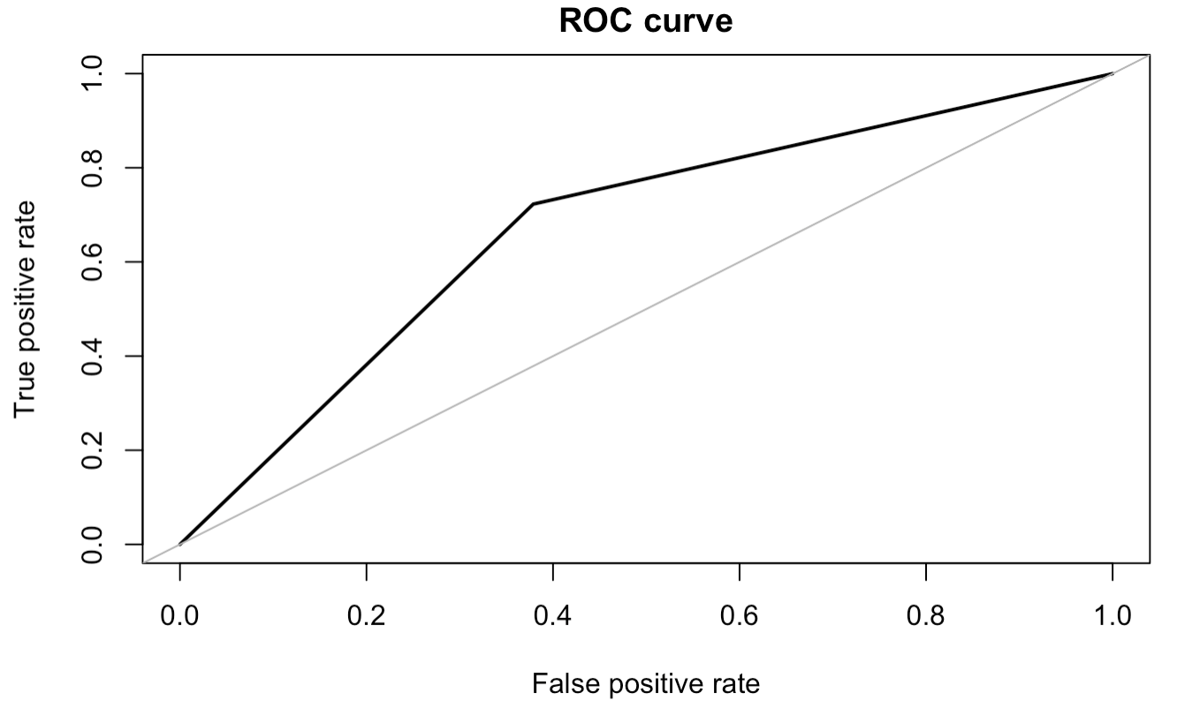
Extreme Gradient Boosting
Implementation of gradient boosted decision trees for speed and performance by minimizing losses from sequentially built trees
Roc curve
Metrics
Accuracy | 67.2%
Sensitivity | 72.3%
Specificity | 62.1%
AUC | 0.672

Slide 17
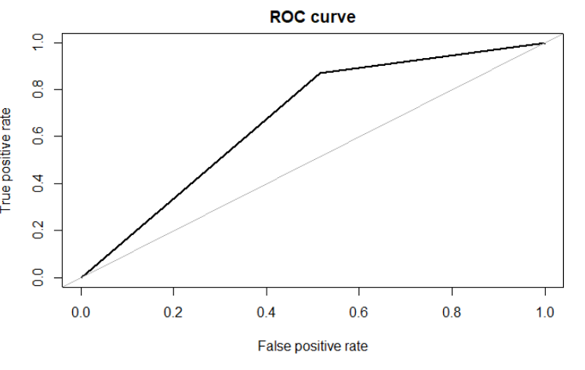
KNN - K-Nearest Neighbors
Classifies outcomes to the class that is most common among its K-nearest neighbors
Roc curve
Metrics
Accuracy | 68%
Sensitivity | 87.1%
Specificity | 48.5%
AUC | 0.678
Notes:
Kaiyu

Slide 18
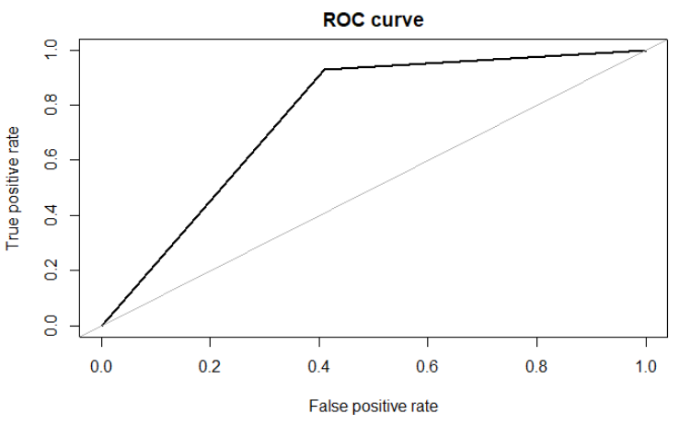
Random Forest
Model uses averages of results from multitude of decision trees trained using bagging method
Roc curve
Metrics
Accuracy | 76.3%
Sensitivity | 93.1%
Specificity | 59.1%
AUC | 0.761

Slide 19
Model Selection
The best model is selected based on key features and metric performances
Approach
Key Predictors
Based on this approach, we have selected the best fit model
Across our models, the most impact predictors are - [age, sysBP, BMI]
The variables that have least impact are - [education, is_male]
Metrics
We looked at accuracy, sensitivity, specificity and AUC as key metrics to assess model performance.
Model ROC curves are also considered.
Real World Impact
Since this is a disease prediction problem, sensitivity is an extremely valuable metric as fewer cases of the disease get missed if sensitivity is high.
Notes:
Chun
Your could talk about why the sensitivity is important.

Slide 20
Results From Each Model
Key metrics for each model
 | Accuracy | Sensitivity | Specificity | AUC
Lasso Classification | 0.660 | 0.876 | 0.439 | 0.658
Ridge Classification | 0.655 | 0.871 | 0.434 | 0.653
KNN - K-Nearest Neighbors | 0.680 | 0.871 | 0.485 | 0.678
Decision Tree | 0.660 | 0.599 | 0.772 | 0.661
Logistic Regression | 0.663 | 0.842 | 0.480 | 0.661
Random Forest | 0.763 | 0.931 | 0.591 | 0.761
Boosting | 0.672 | 0.722 | 0.621 | 0.672
Notes:
Chun

Slide 21
Key Takeaways
Methods to deal with unbalanced dataset:
Undersampling
Oversampling
Both under and oversampling
Above methods can be done on either test or train or both datasets, resulting in sampling 9 times for each model to select the best performing sample
Tradeoff of sensitivity and specificity
When choosing a threshold(cut-off value), we had to consider the cost of false positives and false negatives.

Slide 22
Future Study to Improve Model Performance
Feature Selection
Tuning Hyperparameters
Collecting more relevant data
More methods to deal with unbalanced data
Notes:
kaiyu

